Slide 1


Smart lightning with IOT
COER UNIVERSITY

Slide 2
OBJECTIVE
The Smart Lighting Control System aims to create an intelligent, user-friendly, and highly customizable lighting experience. The objectives are divided into functional, advanced, and utility-based goals to ensure a complete and practical IoT lighting solution.
Functional Objectives:
The system will provide a seamless web-based interface that allows users to easily toggle power for each individual smart bulb. It will support real-time brightness adjustment, enabling smooth dimming from 0% to 100% based on user preference. A fully interactive RGB color control panel will allow users to choose from millions of colors. Additionally, the system will enable users to group bulbs into different rooms, making multi-bulb management simple and organized.
Advanced Feature Objectives:
The system will include smart lighting modes such as Night Mode, offering a soft, warm, low-brightness preset for nighttime use. A dynamic Disco Mode will provide cycling color animations for entertainment, while a Breathing Effect will create a gentle pulsing glow. Users will also be able to save and reuse custom lighting presets combining colors and brightness settings.
Utility & Security Objectives:
Key utility features include an Auto Timer for delayed switching and a Scheduling/Alarm function for daily automated ON/OFF routines. A Lock/Child-Safety mode will ensure accidental changes are prevented, improving security and reliability.

Slide 3
Methodology
The methodology for developing the Smart Lighting Control System focuses on a structured, user-centered, and technology-efficient approach. First, the system’s data is organized into a single JavaScript object that holds all bulbs, rooms, and their configurable attributes. This object acts as the “brain” of the system, controlling operations like toggling power, adjusting brightness, selecting RGB colors, and activating modes. To maintain persistence across browser sessions, all essential data is saved using localStorage, ensuring that user preferences and configurations automatically load whenever the interface is reopened.
For the front-end implementation, the methodology adopts a modular, component-based structure. Separate JavaScript functions are used to render room lists, bulb lists, and the active bulb interface, ensuring clean separation of logic. TailwindCSS provides rapid UI styling with utility-first classes, enabling responsive layouts and consistent design. SVG graphics are used to visually represent bulbs, allowing color, glow intensity, and animations to be updated in real time through JavaScript attribute manipulation.
Advanced features such as Night Mode, Disco Mode, Breathing Effect, and custom presets are implemented using timed intervals, color-transition functions, and dynamic class toggling. The methodology also includes user-friendly controls like sliders, color pickers, timers, and scheduling options to create an intuitive and seamless smart-lighting experience.

Slide 4
BRIEF DESCRIPTION OF PROJECT (TECHNOLOGIES USED)
The provided project is a Smart Bulb Remote Application, a purely client-side web simulation designed to manage and control virtual smart home lighting. Built with HTML5, Tailwind CSS, and Vanilla JavaScript, the application allows users to simulate control over light bulbs grouped into different Rooms. Its core functionality includes toggling power, adjusting brightness via a range slider, and setting the bulb's color using a color picker or direct RGB input. Key features extend to specialized modes like Night Mode (pre-set warm, dim light), Disco Mode (a timed color-cycling animation), and a subtle Breathing Mode (pulsing glow animation), all rendered dynamically using JavaScript to modify the inline SVG bulb graphic and its associated CSS filters. All configurations, including rooms, bulbs, and custom Presets, are saved using the browser's Local Storage for persistence. Furthermore, the app includes utility functions for timers and scheduling (setting daily ON/OFF times), a system log for tracking events, and a Lock feature for safety, demonstrating a comprehensive implementation of typical smart home app controls within a single-page interface.

Slide 5
Problem Outcomes
The problem outcome of using this Smart Bulb Remote Application simulation is the successful demonstration of complex, real-time device control and state management entirely within a web browser. The application effectively provides a persistent, interactive user interface that allows for the simultaneous management of multiple virtual devices (bulbs) across different organizational groups (rooms). This solution verifies that modern front-end technologies can handle dynamic UI updates, intricate animations (like Disco and Breathing modes), state synchronization via Local Storage, and time-based automation (Timers and Schedules) without requiring a backend server. The final result is a fully functional prototype that accurately replicates the look, feel, and core control capabilities of a professional smart lighting application, offering a foundation for understanding the challenges and solutions in developing responsive IoT control interfaces.

Slide 6
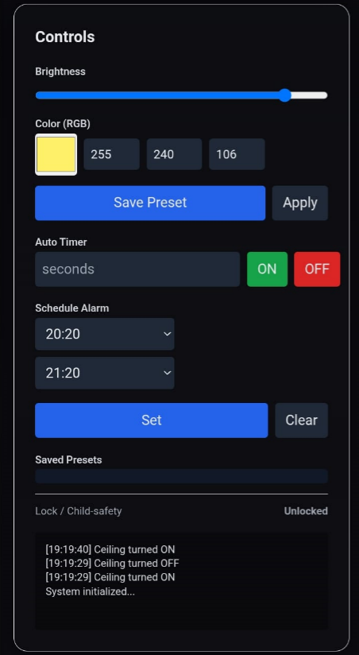
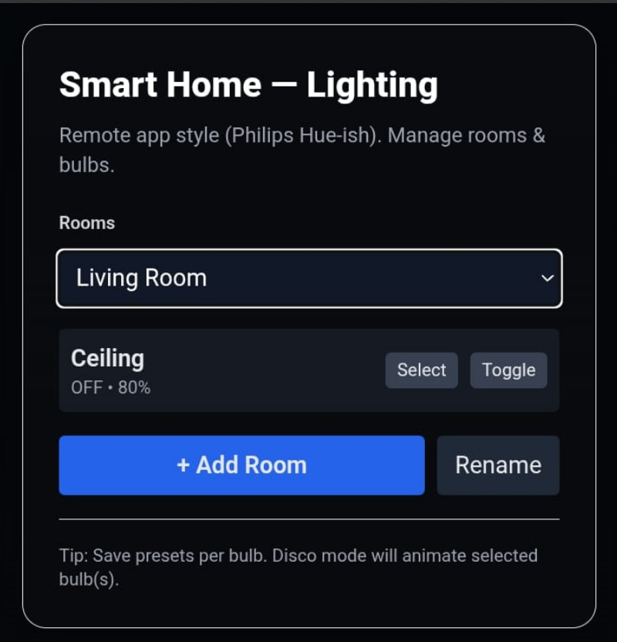
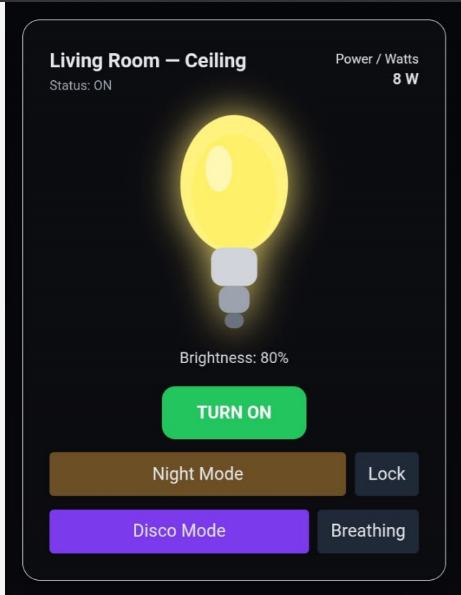
SCREEN SHOTS OF PROJECT

Slide 7



THANK YOU!

